Slide 1
Chavez FFA Meeting
10/4/2017

Slide 2
Why are we here?
To Practice Brotherhood
Honor Agriculture Opportunities and responsibilities, and too develop those qualities of leadership a FFA member should possess.

Slide 3
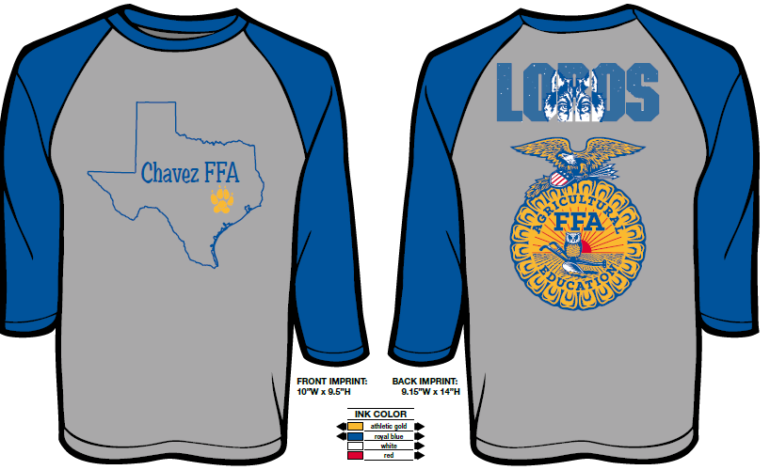
T Shirts On Sale now

Slide 4
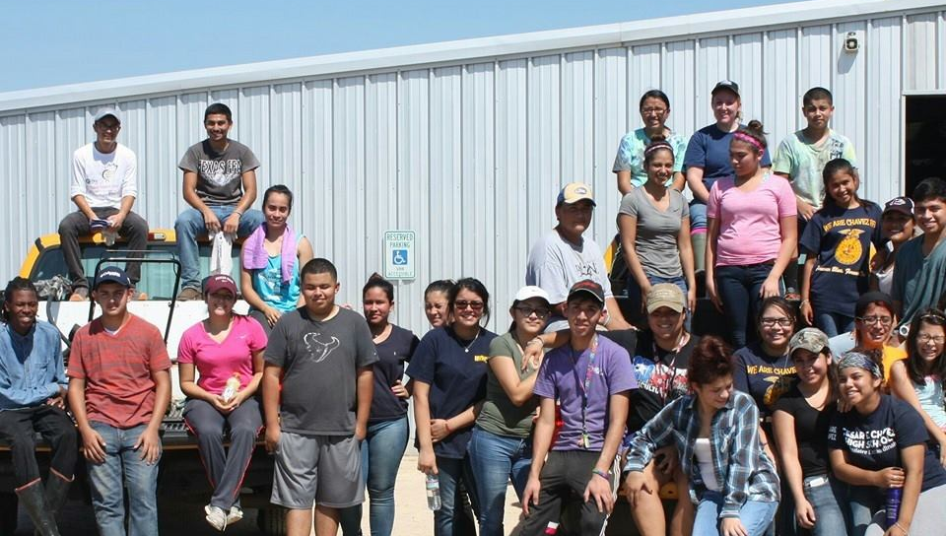
Community Service
Saturday November 4th
Dona Marie Clubhouse 9:00am- 12:00 pm
Wednesday December 6th
Houston Food Bank 6-9pm

Slide 5
Year book Picture
December 6th At our meeting
Full official Dress Required

Slide 6
LDE Teams
Please Stand if you are on a team competing Monday!
Public Relations
Ag Advocacy
Senior Creed
Senior Skills
Senior Quiz

Slide 7
Harris County Congrats
Citlally Covarrubias
Jesus Cruz
Jossue Lopez
Ana Martinez
Cristian Viguerias

Slide 8
Would you like to become an Officer?
We are looking for the following
Sentinel & Reporter
Advisor & Treasurer
Applications will be given Tuesday November 7th and will be Due November 21st we will vote at Dec Meeting!

Slide 9
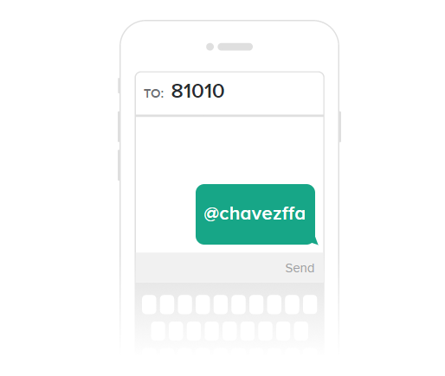
FFA Remind
Please Join the Chavez FFA Remind for Chapter Updates.

Slide 10
Barn Party!
December 15th 6:00 pm -12:00am
$3.00 to reserve spot and buy snacks
New Barn
Vote:
Secret Santa or White Elephant

Slide 11
Wearing Jackets
Official FFA Jackets are a source of pride and tradition.
If you cannot appropriately wear them you do not need to bring it to campus.
Campus is the only place you can wear it out of official code

Slide 12
Game Time
Mummy Relay
Teams of 3
Dress your Mummy
Mummies race to finish line
Emblem Game
Get a clipboard and a piece of paper
Need a pen
Place on your head
Have 1.5 minutes to draw the best emblem possible

Slide 13
Adjorn
“Madam President”
“Yes”
“I move that we adjourn this meeting and go eat Pizza.”
“I second”
“It has been moved and seconded that we adjourn this meeting, this motion is not debatable and is amendable to time only, is there any discussion?”
Being none we will proceed to vote, all those in favor say aye, all opposed say no”
The ayes have it, we are about to adjourn this meeting of the Chavez FFA chapter. Mdm secretary do you………

