Slide 1
Chavez FFA Meeting
12/6/2017

Slide 2
Why are we here?
To Practice Brotherhood
Honor Agriculture Opportunities and responsibilities, and too develop those qualities of leadership a FFA member should possess.

Slide 3
Food Bank
Tonight
6-9 pm
535 Portwall Street
Closed toes shoes and pants
Register NOW

Slide 4
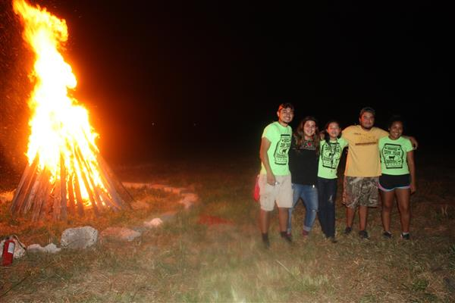
Barn Party
Friday December 15th
6pm- Midnight
New Farm
Entry is $5.00 plus white elephant gift

Slide 5
White Elephant
Bring a wrapped gift
Put gift in middle of circle
Draw numbers to see order
#1 gets to pick a present from middle first
#1 Opens presents and shows everyone
#2 can either steal present from #1 OR pick a new present from middle etc. etc
A present can only be stolen 3 times
Gifts should be less than $10.00

Slide 6
Wearing Jackets
Official FFA Jackets are a source of pride and tradition.
If you cannot appropriately wear them you do not need to bring it to campus.
Campus is the only place you can wear it out of official code

Slide 7
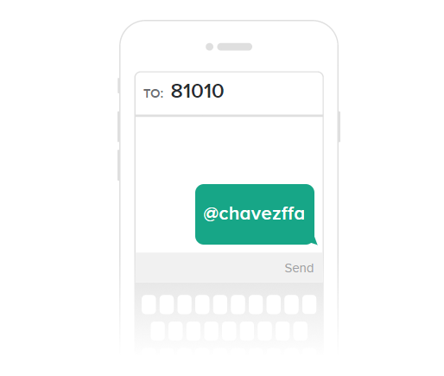
FFA Remind
Please Join the Chavez FFA Remind for Chapter Updates.

Slide 8
Congratulations New Officers!
Bianca Ovalle
Reporter
Janet Tueme
Treasurer
Laura Garcia
Sentinel

Slide 9
Adjorn
“Madam President”
“Yes”
“I move that we adjourn this meeting and go eat Pizza.”
“I second”
“It has been moved and seconded that we adjourn this meeting, this motion is not debatable and is amendable to time only, is there any discussion?”
Being none we will proceed to vote, all those in favor say aye, all opposed say no”
The ayes have it, we are about to adjourn this meeting of the Chavez FFA chapter. Mdm secretary do you………

